Slide 1
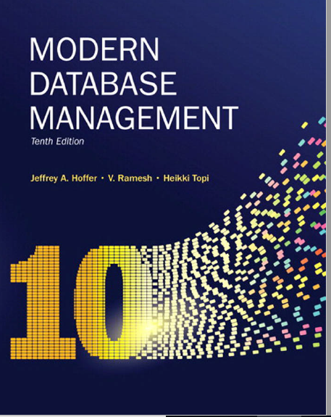
Chapter 6: Introduction to SQL
DDL and DML

Slide 2
Agenda
Data populations using INSERT
Identity columns
SELECT statements
Aggregate Functions
Boolean Expressions
Table Aliases
Views
Notes:
Drop table in the reserve order on how they were created

Slide 3
Remove and Recreate all 4 Tables
Remove all tables
DROP TABLE Product
DROP TABLE OrderLine
DROP TABLE Order
DROP TABLE Customer
Re-create all tables by running the script PineValey_CREATE_table

Slide 4
Insert Statement
Adds one or more rows to a table
Inserting into a table
INSERT INTO CUSTOMER VALUES
(1, 'Contemporary Casuals', '1355 S. Himes Blvd.', 'Gainesville', 'FL', '32601');
Msg 213, Level 16, State 1, Line 1
Column name or number of supplied values does not match table definition.
We need to add value for Customer Type:
INSERT INTO CUSTOMER VALUES
(1, 'Contemporary Casuals', '1355 S. Himes Blvd.', 'Gainesville', 'FL', '32601', 'Commercial');
Notes:
Recreate the tables again
Have students perform this function

Slide 5
INSERT INTO CUSTOMER
INSERT INTO CUSTOMER VALUES
(1, 'Contemporary Casuals', '1355 S. Himes Blvd.', 'Gainesville', 'FL', '32601', 'Commercial');
INSERT INTO CUSTOMER VALUES
(2, 'ABC Inc', '11 Main ST', 'Boston', 'MA', '02771', 'Commercial');
INSERT INTO CUSTOMER VALUES
(3, 'XYZ Inc', '16 John Ave', 'Boston', 'MA', '02771', 'Commercial');

Slide 6
INSERT INTO PRODUCT
INSERT INTO [Product] ([ProductID]
,[ProductDescription]
,[ProductFinish]
,[ProductStandardPrice]
,[ProductLineID])
VALUES
( 1, 'End Table','Cherry', 175,8 );
INSERT INTO [Product] VALUES
( 2, 'King Chair', 'Natural Oak', 400, 8 );
INSERT INTO [Product] VALUES
( 3, 'Big Table', 'Natural Oak', 330, 8 );
INSERT INTO [Product] VALUES
( 4, ‘Small Desk', ‘Cherry’, 220, 8 );

Slide 7
Write SQL for the following event
Contemporary Casuals (customer) places an order today .
The order contains the following products:
2 Cherry End Tables
1 A king Chair in natural oak finish.
Notes:
INSERT INTO [dbo].[Order] ([OrderID] /*,[OrderDate] */ ,[CustomerID])
VALUES (1,1);
/* why is orderdate commented out?*/
INSERT INTO [dbo].[OrderLine] ([OrderID] ,[ProductID] ,[OrderQuantity])
VALUES(1,1,2);
INSERT INTO [dbo].[OrderLine] ([OrderID] ,[ProductID] ,[OrderQuantity])
VALUES(1,2,1);

Slide 8
Set-based INSERT statement
Create a CustomerMA table, and INSERT rows from Customer
CREATE TABLE [dbo].[CustomerMA](
[CustomerID] [int] NOT NULL,
[CustomerName] [nvarchar](25) NULL,
[CustomerAddress] [varchar](30) NULL,
[CustomerCity] [varchar](20) NULL,
[CustomerState] [char](2) NULL,
[CustomerPostalCode] [varchar](9) NULL,
[CustomerType] [varchar](20) NULL,
)
insert INTO CustomerMA
SELECT *
FROM [Customer]
WHERE CustomerState ='MA'
Notes:
Show them how to script from existing object

Slide 9
Different ways to INSERT
Inserting into a single record into a table – every column
Inserting a record that has some null attributes requires identifying the fields that actually get data
Inserting from another table – set-based operation
INSERT INTO CUSTOMER VALUES
(1, 'Contemporary Casuals', '1355 S. Himes Blvd.', 'Gainesville', 'FL', '32601', 'Commercial');
INSERT INTO [dbo].[Order] ([OrderID] /*,[OrderDate] */ ,[CustomerID]) VALUES (1,1);
insert INTO CustomerMA
SELECT *
FROM [Customer]
WHERE CustomerState ='MA'
Notes:
Recreate the tables again
Have students perform this function

Slide 10
Delete Statement
Removes rows from a table
Delete certain rows
DELETE FROM CUSTOMER WHERE CUSTOMERSTATE = ‘MA’
Delete all rows
DELETE FROM CUSTOMER;
Another way to remove records from all table is TRUNCATE statement
Example : TRUNCATE TABLE Customer
The main difference between TRUNCATE and DELETE are:
TRUNCATE is considered a DDL, DELETE is DML
TRUNCATE doesn’t log the operation ( will cover later)

Slide 11
Update Statement
Modifies data in existing rows
update PRODUCT
SET ProductStandardPrice = 200
WHERE ProductID=1

Slide 12
Creating Tables with Identity Columns
CREATE TABLE Customer1
(
CustomerID int not null IDENTITY(1,1),
CustomerName nvarchar(25),
CustomerAddress varchar(30),
CustomerCity varchar(20),
CustomerState char(2),
CustomerPostalCode varchar(9)
CONSTRAINT Customer_PK primary key (CustomerID)
);
Inserting into a table does not require explicit customer ID entry or field list
INSERT INTO CUSTOMER1 VALUES ( ‘Contemporary Casuals’, ‘1355 S. Himes Blvd.’, ‘Gainesville’, ‘FL’, 32601);
Notes:
That’s a IBM DB2 syntax, also same syntax as Oracle 12c
Prior to Oracle 12c, Oracle used a combination of sequence and triggers.
SQL Server: Identity (1,1)
MySQL: AUTO_INCREMENT

Slide 13
Data reads
Used for queries on single or multiple tables
Clauses of the SELECT statement:
SELECT
List the columns (and expressions) that should be returned from the query
FROM
Indicate the table(s) or view(s) from which data will be obtained
WHERE
Indicate the conditions under which a row will be included in the result
GROUP BY
Indicate categorization of results
HAVING
Indicate the conditions under which a category (group) will be included
ORDER BY
Sorts the result according to specified criteria

Slide 14
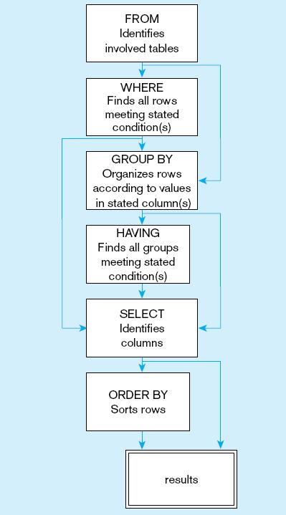
Figure 6-10
SQL statement processing order (adapted from van der Lans, 2006 p.100)

Slide 15
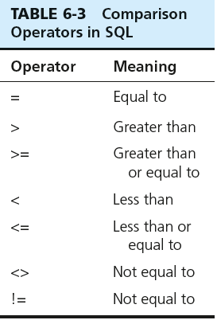
SELECT Example
Find products with standard price less than $275
select *
from dbo.product
WHERE [ProductStandardPrice] <275
Table 6-3: Comparison Operators in SQL
Notes:
Show the operators
Go back to SSMS and query the database!
Go over Equal, Less than, >=

Slide 16
SELECT Example Using Alias
Alias is an alternative column or table name
SELECT
CUST.[CustomerName] AS NAME,
CUST.[CustomerAddress]
FROM [dbo].[Customer] CUST
WHERE [CustomerName] = 'Contemporary Casuals'

Slide 17
Basic Boolean Operators
Mathematical sets and database Logic
Three basic operations: AND, OR, and NOT.
Applications
Search multiple terms
Connect information to broaden or narrow your set results
Notes:
Boolean operators form the basis of mathematical sets and database logic.
They connect your search words together to either narrow or broaden your set of results.
The three basic Boolean operators are: AND, OR, and NOT.

Slide 18
AND Example
select *
From [dbo].[Customer]
WHERE CustomerCity ='Boston’ AND [CustomerState] ='MA'

Slide 19
OR Example
select *
From [dbo].[Customer]
WHERE [CustomerState] =‘FL’
OR [CustomerState] ='MA'
Notes:
What happens if I change the or to and AND? No results

Slide 20
SELECT Example – IN
select *
FROM [dbo].[Customer]
WHERE [CustomerState] IN ('MA' ,'FL')
Note: the IN operator in this example allows you to include rows whose CustomerState value is either FL, TX, CA, or HI. It is more efficient than separate OR conditions.
Notes:
IN operator

Slide 21
Wildcard searches - LIKE
SELECT [ProductDescription],[ProductFinish], [ProductStandardPrice]
FROM Product
where [ProductDescription] like '%Desk%'
Note: the LIKE operator allows you to compare strings using wildcards. For example, the % wildcard in ‘%Desk’ indicates that all strings that have any number of characters preceding the word “Desk” will be allowed.
Notes:
Wild card
Explain OR

Slide 22
SELECT Example–Boolean Operators
AND, OR, and NOT Operators for customizing conditions in WHERE clause
SELECT [ProductDescription],[ProductFinish], [ProductStandardPrice]
FROM Product
where [ProductDescription] like '%Desk%'
OR [ProductDescription] like '%Table%'
AND [ProductStandardPrice]>300
Note: the LIKE operator allows you to compare strings using wildcards. For example, the % wildcard in ‘%Desk’ indicates that all strings that have any number of characters preceding the word “Desk” will be allowed.
Notes:
Wild card
Explain OR

Slide 23
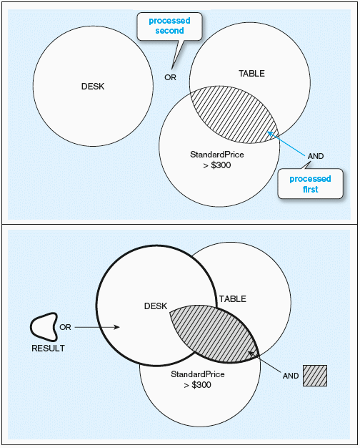
Figure 6-9 Boolean query without use of parentheses
Notes:
Returns

Slide 24
6-9 Boolean query with use of parentheses
With parentheses…these override the normal precedence of Boolean operators
SELECT [ProductDescription],[ProductFinish], [ProductStandardPrice]
FROM Product
WHERE ([ProductDescription] like '%Desk%'
OR [ProductDescription] like '%Table%' )
AND [ProductStandardPrice]>300
Note: by default, the AND operator takes precedence over the OR operator. With parentheses, you can make the OR take place before the AND.
Notes:
What is the difference in results?

Slide 25
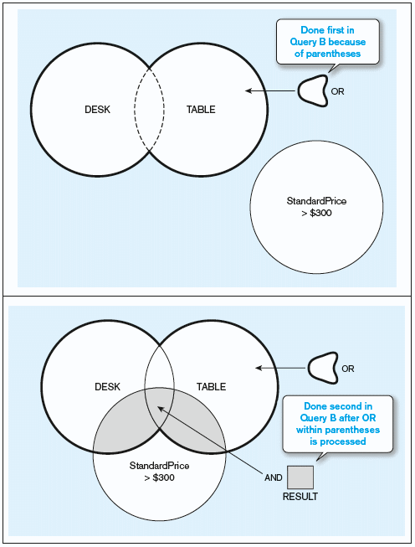
Figure 6-9 Boolean query with use of parentheses
Notes:
AND is always processed first. Then OR

Slide 26
ORDER BY
SELECT [ProductDescription],[ProductFinish], [ProductStandardPrice]
FROM Product
ORDER BY [ProductDescription] ASC
ORDER BY sorts results in the order specified ( either ascending or descending)
Notes:
Default is ascending order

Slide 27
ORDER BY
SELECT [ProductDescription],[ProductFinish], [ProductStandardPrice]
FROM Product
ORDER BY [ProductFinish] ASC, [ProductStandardPrice] DESC
Multiple columns can be specified. The first column sorts the entire result set,
the second column sub sorts the result where the first column is the same, and so on

Slide 28
ORDER BY via column index
Using column names:
SELECT [ProductDescription],[ProductFinish], [ProductStandardPrice]
FROM Product
ORDER BY [ProductFinish] ASC, [ProductStandardPrice] DESC
Using column index:
SELECT [ProductDescription],[ProductFinish], [ProductStandardPrice]
FROM Product
ORDER BY 2 ASC, 3 DESC

Slide 29
Aggregate Functions
SUM -> summation
MIN -> to find the lowest or minimum
MAX -> to find the highest or maximum
AVG -> mean
COUNT -> how may records
Notes:
There are many others, depending on the DBMS system you are using.
STD Deviation of a population
STD Devation of a sample
VAR of Popluation
VAR of a population

Slide 30
SELECT Example Using a Function
Using the COUNT aggregate function to find totals
SELECT COUNT(*) FROM Product
Note: with aggregate functions you can’t have single-valued columns included in the SELECT clause, unless they are included in the GROUP BY clause
Notes:
Aggregate functions in SQL. In database management an aggregate function is a function where the values of multiple rows are grouped together as input on certain criteria to form a single value of more significant meaning. ... Count(salary): Return number of Non-Null values over the column salary.

Slide 31
SELECT Example– Categorizing Results Using the GROUP BY Clause
For use with aggregate functions
Scalar aggregate: single value returned from SQL query with aggregate function
Vector aggregate: multiple values returned from SQL query with aggregate function (via GROUP BY)
Note: you can use single-value fields with aggregate functions if they are included in the GROUP BY clause
SELECT [CustomerState], COUNT(*)
FROM CUSTOMER
GROUP BY [CustomerState]

Slide 32
SELECT Example– Qualifying Results by Categories Using the HAVING Clause
For use with GROUP BY
Like a WHERE clause, but it operates on groups (categories), not on individual rows. Here, only those groups with total numbers greater than 1 will be included in result.
SELECT [CustomerState], COUNT([CustomerState])
FROM CUSTOMER
GROUP BY [CustomerState]
HAVING COUNT([CustomerState])>1

Slide 33
SELECT DISTINCT
SELECT DISTINCT CustomerState
FROM Customer;
Results:
Removes duplicate, and only displays one instance of each row defined on the SELECT clause
CustomerState
FL
MA

Slide 34
Using and Defining Views
Views provide users-controlled access to tables
Base Table–table containing the raw data
Dynamic View
A “virtual table” created dynamically upon request by a user
No data stored; instead, data from base table made available to user
Based on SQL SELECT statement on base tables or other views
Materialized View
Copy or replication of data
Data actually stored
Must be refreshed periodically to match the corresponding base tables
Notes:
Materialized views in Oracle, they are called Indexed views in SQL Server which are based on clustered index

Slide 35
Sample CREATE VIEW
CREATE VIEW vw_EnpensiveStuff AS
SELECT [ProductDescription],[ProductFinish], [ProductStandardPrice]
FROM Product
WHERE [ProductStandardPrice]>300
WITH CHECK OPTION;
View has a name
View is based on a SELECT statement
CHECK_OPTION works only for updateable views and prevents updates that would create rows not included in the view
Notes:
Materialized views

Slide 36
Advantages of Views
Simplify query commands
Assist with data security (but don't rely on views for security, there are more important security measures)
Enhance programming productivity
Contain most current base table data
Use little storage space
Provide customized view for user
Establish physical data independence

Slide 37
Disadvantages of Views
Use processing time each time view is referenced
May or may not be directly updateable (could also be an advantage if that’s the behavior you want)

